Slide 1


DESIGN 1
Lesson 4: Formative: F1 Forms and Navigation
Ms. Abboud • Grade 9 - Design 1 • Term 1, Week 9

Slide 2
Learning Objectives
WALT - We Are Learning To
WILF - What I'm Looking For
Show working, correctly labelled forms linked into the site's navigation.
I build functional forms.
I apply form elements correctly.
I collect information successfully.

Slide 3
Frayer Model: Form (Review)
DEFINITION
CHARACTERISTICS
The <form> tag: a container that groups input fields together so a website can collect information from a user.
The <form> tag; groups inputs together; used to collect data.
FORM
EXAMPLES
NON-EXAMPLES
The F1 contact form on Contact Us.
A <table>; a paragraph asking a question with no inputs.

Slide 4
National Identity Integration
UAE Smart Services: most UAE government services, from visas to vehicle registration, are requested online through forms. Clear labels make sure every resident can fill them in correctly.

Slide 5
STARTER
Match the Tag
form, input, label, textarea, button, radio, checkbox, select.
Match each one to its job.
Hook • Engage & Ask
5 - 10 minutes

Slide 6
LESSON CORE
I Do: The Formative and Rubric
HTML Forms & Navigation Activities (10 pts): functional form 4, correct labelling 3, navigation 3.
Finish both forms, then go through the Final Checklist.
Gradual Release of Responsibility
30 - 40 minutes
1 / 3

Slide 7
LESSON CORE
We Do: Stuck? Use the Example
Ask for the Example Code sheet and compare one line at a time.
Peer test: try every field and every menu link.
Gradual Release of Responsibility
30 - 40 minutes
2 / 3

Slide 8
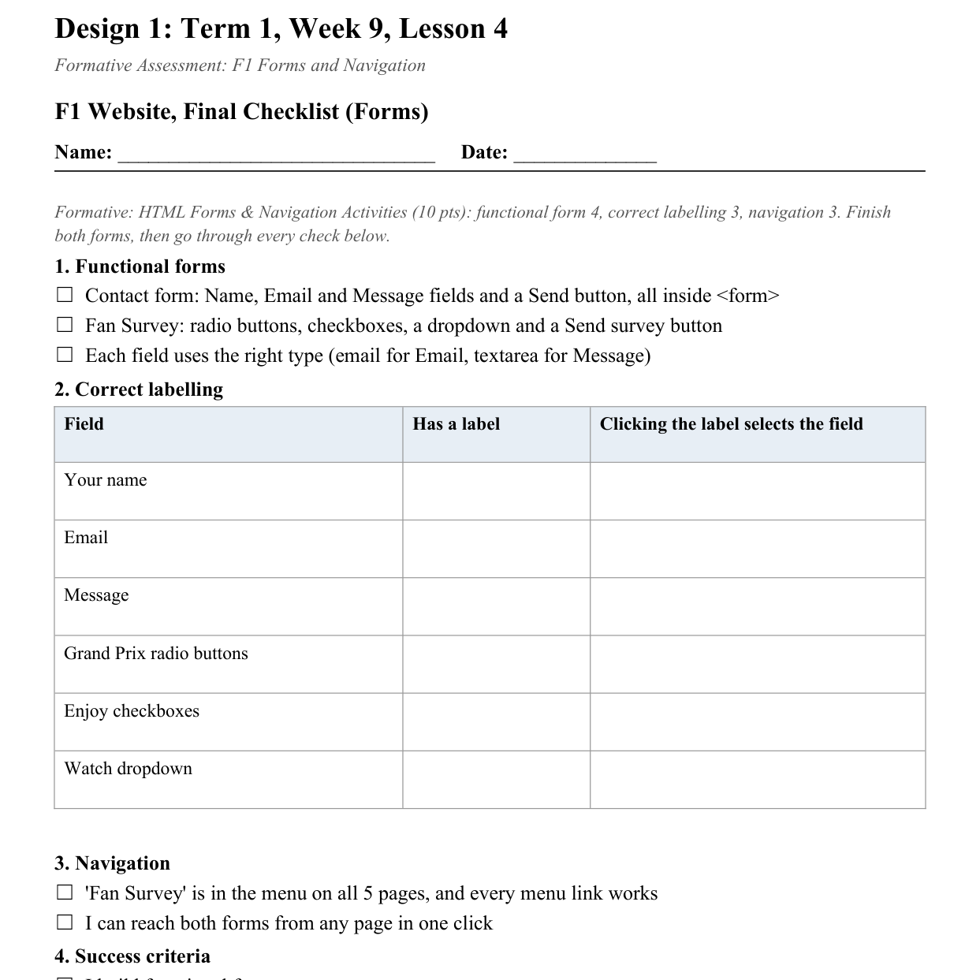
LESSON CORE
You Do: Finish, Check, Submit
Tick every item on the Final Checklist (Forms).
Fix what your partner found, then submit via Toddle.
Activity: F1 Website, Final Checklist (Forms)
Gradual Release of Responsibility
30 - 40 minutes
3 / 3

Slide 9
CLOSURE
Exit Ticket
What's one more field or feature you'd add to your form if you had more time?
Transition & Extend
5 - 10 minutes

